Slide 1


Analytics Practicum II
Case Study: Dementia in Greece compared to other European countries
Matsanganis Dimitrios, f2822212
Professor: Mr. Karlis Dimitrios
May 25th 2023

Slide 2
What is Dementia ?
Dementia is a term used to describe a group of progressive neurological disorders characterized by a decline in cognitive function, memory loss, and difficulties in thinking, reasoning, and problem-solving.
It is commonly associated with aging but can also occur in younger individuals. Dementia affects a person's ability to perform daily activities and can have a significant impact on their quality of life.
The condition is often caused by diseases such as Alzheimer's disease, vascular dementia, or Lewy body dementia.
Early diagnosis, management of symptoms, and support are essential for individuals living with dementia and their caregivers.
Dimitrios Matsanganis, f2822212
Analytics Practicum II - Project I

Slide 3
How can we compare Dementia over different EU countries ?
The use of standardized death rates (SDRs) is a preferred choice for comparing dementia mortality across different countries because it provides a more accurate and meaningful comparison while accounting for differences in population age structures. Comparing the number of occurrences or cases of dementia alone may not provide a fair comparison due to variations in population demographics, such as age distribution or population’s size. Also, by using SDRs, which adjust for age and sex, comparisons can be made while minimizing the influence of differences in population age compositions.
Therefore, standardizing the death rates allows for a more reliable assessment of the relative burden of dementia mortality across different populations or over time. It helps to account for the varying age-specific risks and provides a clearer understanding of the impact of dementia on mortality rates in a standardized manner (Source: Eurostat).
Dimitrios Matsanganis, f2822212
Analytics Practicum II - Project I

Slide 4
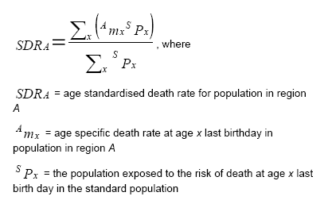
But…What is Standardised Death Rate (SDR)?
The standardized death rate (SDR) is a measure of mortality adjusted for age and sex by comparing death rates in different populations or over time. It calculates a weighted average of age-specific death rates using a standard age distribution. This allows for better comparability as most causes of death vary significantly with age and sex. Eurostat uses the 'European Standard Population' revised in 2012 to calculate SDRs using the direct method. SDRs are computed for different age groups (0-64 and 65+), as well as for all ages (Source: Eurostat).
Dimitrios Matsanganis, f2822212
Analytics Practicum II - Project I

Slide 5
After the necessary theory, now we can move to a Visual Exploration of Dementia Mortality Analysis Using Standardized Death Rates
Dimitrios Matsanganis, f2822212
Analytics Practicum II - Project I

Slide 6
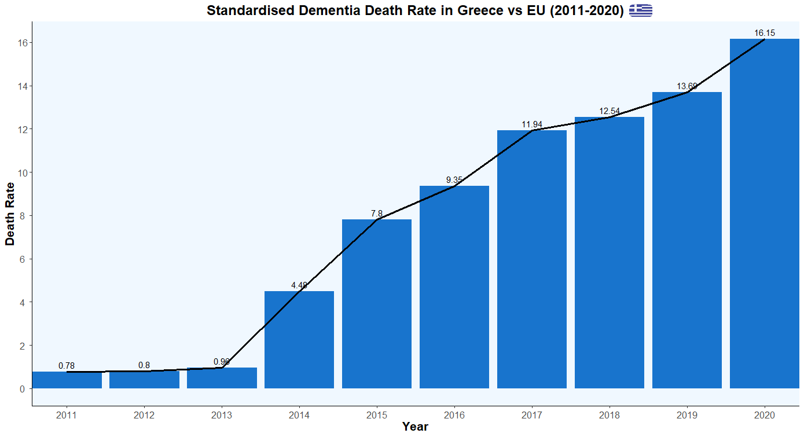
Project analysis slide 10
Standardized Dementia Death Rate in Greece (2011-2020)
The barplot shows a steady increase regarding dementia in Greece over the years. From 2011 to 2020, there is a clear upward trend and an accelerated growth, indicating a rise in the number of reported cases of dementia.
There is a significant increase in death rates between 2011 (0.78) and 2020 (16.15). A pronounced and abnormal surge in dementia cases noted between 2013 and 2014.
The period encompassing the COVID years, 2019 to 2020, does not appear to have had a significant impact on the growth of dementia cases. The prevalence of dementia continued to increase at a normal rate during this time.
Dimitrios Matsanganis, f2822212
Analytics Practicum II - Project I

Slide 7
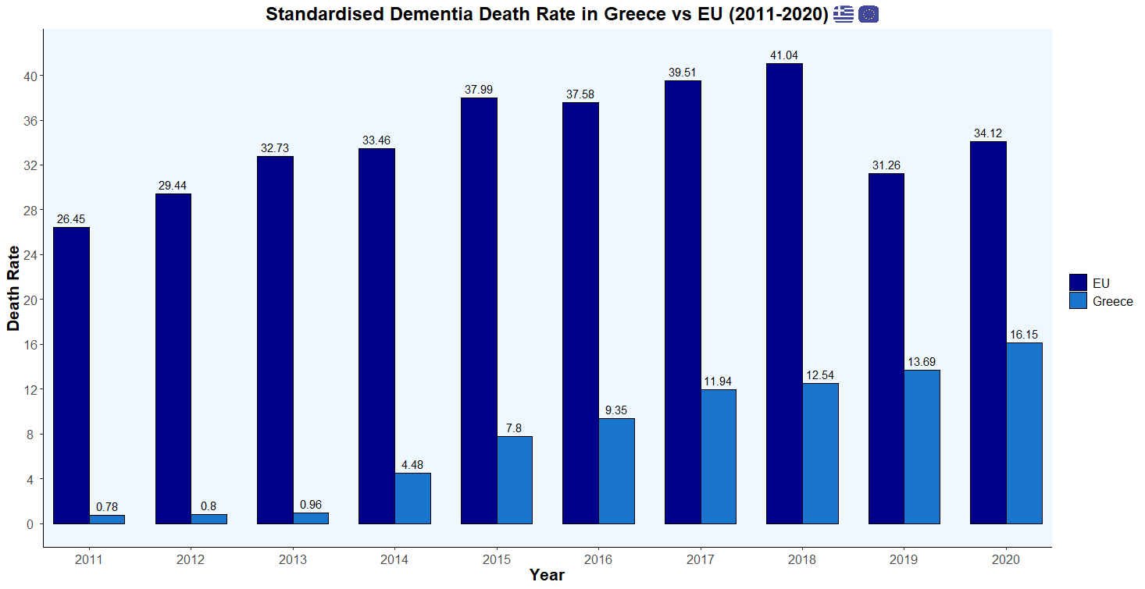
Project analysis slide 10
Standardized Dementia Death Rate in Greece vs Europe (2011-2020)
From this graph we can notice that Greece experienced a gradual increase in the dementia death rate from 2011 to 2015, followed by a more significant increase from 2016 to 2020.
The EU's dementia death rate consistently increased from 2011 to 2018, while a slight decrease occurred in 2019 and 2020. This is may be due to the absence of UK’s data the highest average in the previous years.
Greece consistently had lower dementia death rates than the European Union throughout the provided years. However, the gap between the rates narrowed in 2019 and 2020.
Dimitrios Matsanganis, f2822212
Analytics Practicum II - Project I

Slide 8
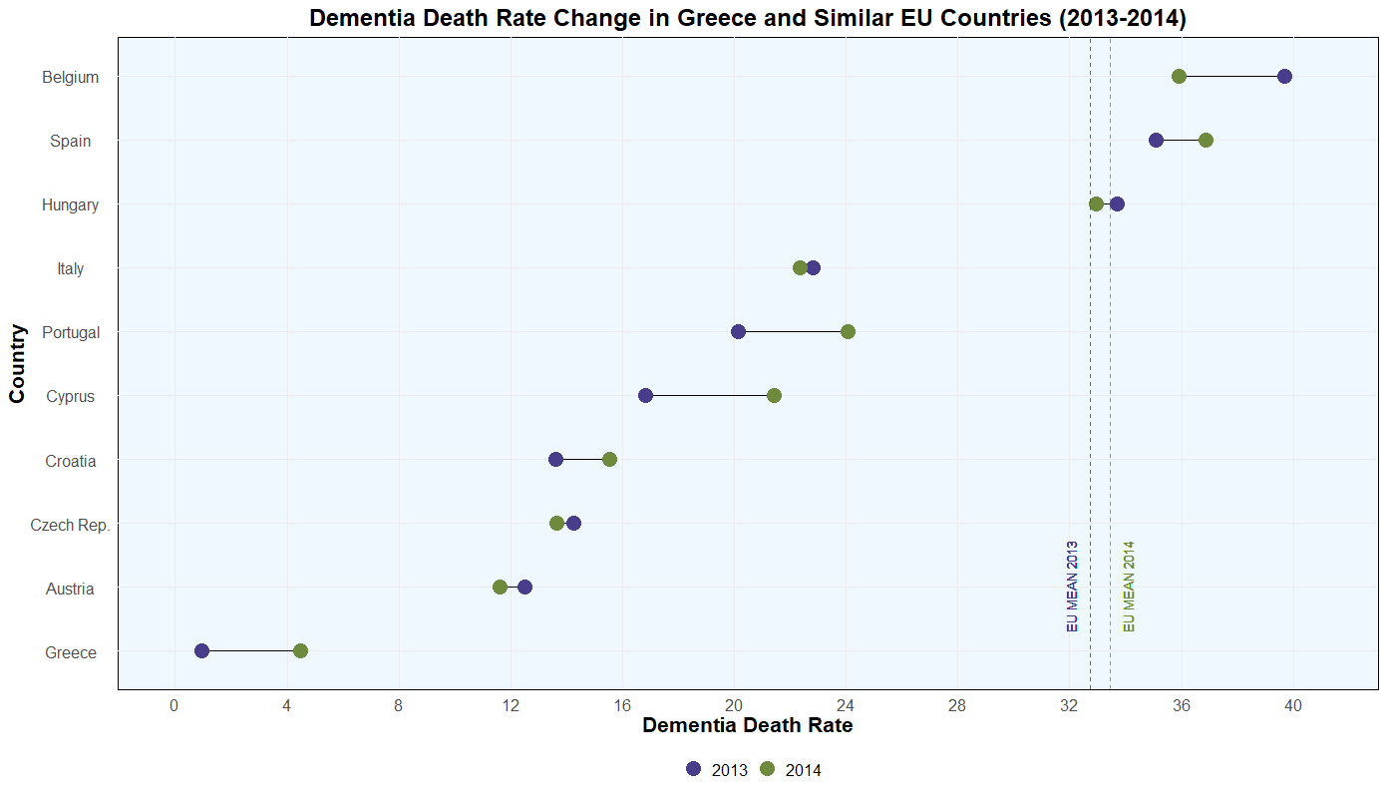
Project analysis slide 10
Dementia Death Rate Change in Greece and Similar EU Countries (2013-2014)
In this graph, a comparison is presented between the dementia death rate in Greece and the rates of other EU countries that exhibit similarities either demographically, socioeconomically, or topographically, for 2013 and 2014. The vertical lines represent the total EU’s average for 2013 and 2014.
By employing this graph, the aim is to facilitate the identification of any notable patterns, trends, or differences in dementia death rates among the selected countries.
There has been a notable abnormal change, similar to that observed in Greece, in the countries of Portugal, Spain, and Cyprus. In contrast, the overall average for the European Union (EU) indicates a relatively milder shift. Additionally, Belgium has exhibited a contrasting pattern, with an exact opposite change, indicating a decrease in the death rate.
Dimitrios Matsanganis, f2822212
Analytics Practicum II - Project I

Slide 9
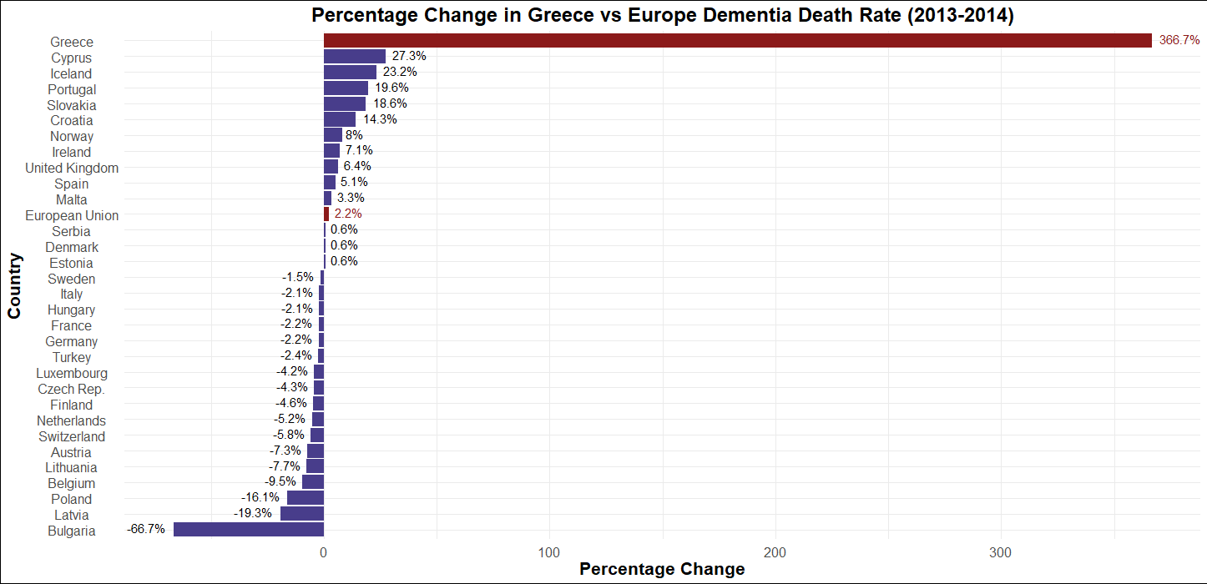
Project analysis slide 10
Percentage Change in Greece vs Europe Dementia Death Rate (2013-2014)
This graph depicts the dementia death rate changes regarding the years 2013-2014. The EU average percentage change in dementia death rates was 2.23%. Greece's increase of 367% is significantly higher than the EU average, indicating a more pronounced change compared to other EU countries.
Greece's percentage change of 367% places it at the highest increase among the listed countries in and way ahead from the EU average.
Portugal, Cyprus, Spain, and Croatia as previously mentioned had a relatively higher increase than the average EU country, while Belgium presents a decrease of 9.5%.
Apart from it, Bulgaria experienced the highest decrease with a percentage change of -66.7% and Estonia had the lowest increase with a percentage change of 0.6%.
Dimitrios Matsanganis, f2822212
Analytics Practicum II - Project I

Slide 10
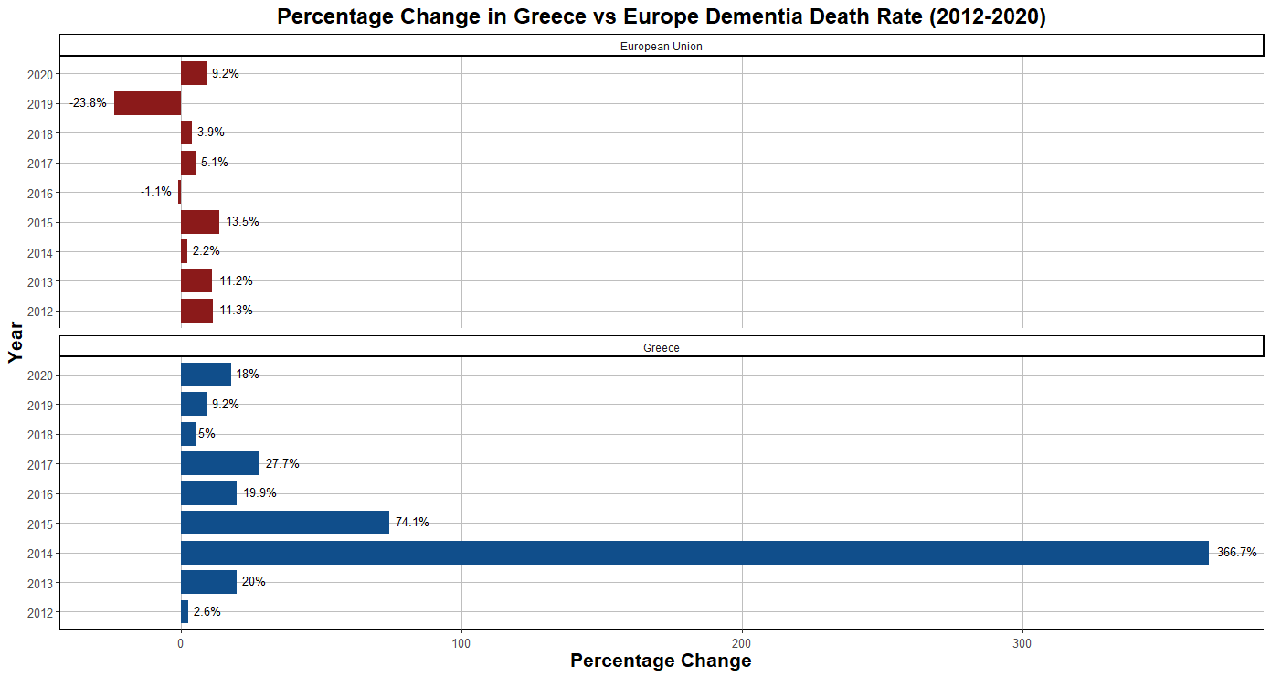
Project analysis slide 10
Percentage Change in Greece vs Europe Dementia Death Rate (2012-2020)
Greece's death rates generally increased more each year than the European Union, except in 2012.
As noted earlier, in 2014, Greece had an abnormal increase of 367% compared to 2% of Europe’s average.
In 2016, Greece witnessed a substantial 20% surge in death rates, while Europe observed a modest 1% decline.
Similarly, in 2019, Greece recorded a notable 9% increase, whereas the European Union experienced a significant decrease of 24%.
Dimitrios Matsanganis, f2822212
Analytics Practicum II - Project I

Slide 11
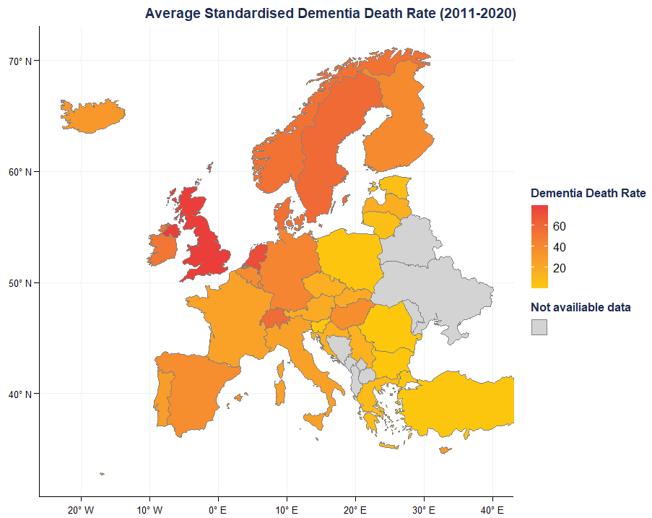
Project analysis slide 10
Average Standardised Dementia Death Rate (2011-2020)
The countries with the highest death rates of dementia are the United Kingdom (79.29), Netherlands (72.8), and Sweden (58.24). Other countries with relatively high death rates include Denmark (54.61), Ireland (51.48).
This indicates that countries in Northern Europe, such the above mentioned, exhibit higher death rates of dementia.
One notable abnormal is Malta, a Southern European country, which has a relatively high death rate of dementia (51.69).
Greece has a comparatively lower death rate of dementia (7.84), like the most of the Balkans and Southern Europe, with Romania having the smaller one of about 2%.
Dimitrios Matsanganis, f2822212
Analytics Practicum II - Project I

Slide 12
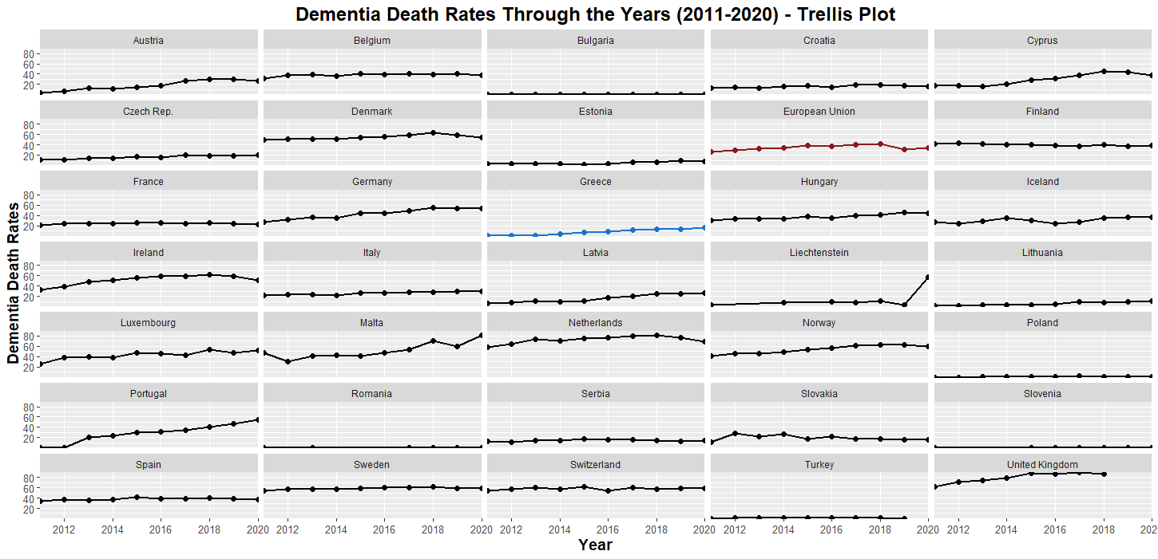
Project analysis slide 10
Dementia Death Rates Through the Years (2011-2020) - Trellis Plot
The above trellis plot illustrates the trend line of the dementia death rate across the EU countries over the years. An examination of the plot reveals a predominant upward trend in most of the European countries.
Based on the colored area of each graph, it is evident that most countries have significantly higher values throughout the years compared to Greece.
Dimitrios Matsanganis, f2822212
Analytics Practicum II - Project I

Slide 13
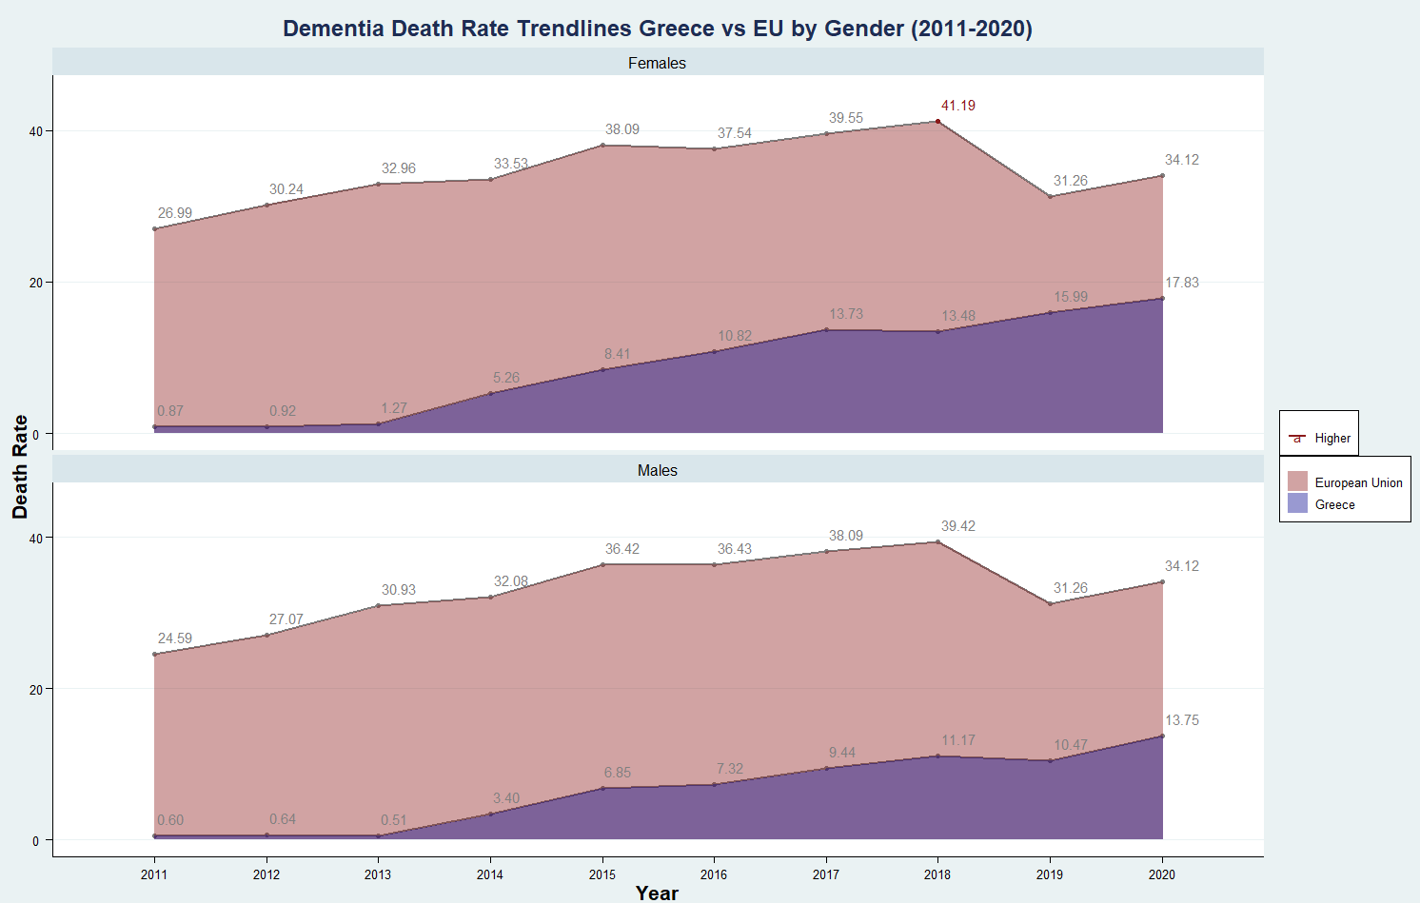
Project analysis slide 10
Dementia Death Rate Trendlines Greece vs EU by Gender (2011-2020)
This graph displays the trendlines of dementia death rates in Greece compared to the European Union between the years 2011 and 2020. The data is separated by gender, with separate plots for males and females.
The Females have higher values of dementia death rates than the Males in all years, expect the two last years in EU’s average (where the data are provided to be equal).
The higher value of dementia death rate origins from Females EU’s average in 2018 (41.19), while the second higher is the previous year one (2017 - 39.55). Regarding the Males the higher value origins from EU’s 2018 (39.42).
For Greece the higher rates for both genres origins from the 2020 year (13.75 Males - 17.83 Females).
The trend of dementia death rate increasing regardless of the genre except the 2019 one for all combinations apart from the Greece’s Females, which continue to rise.
Dimitrios Matsanganis, f2822212
Analytics Practicum II - Project I

Slide 14
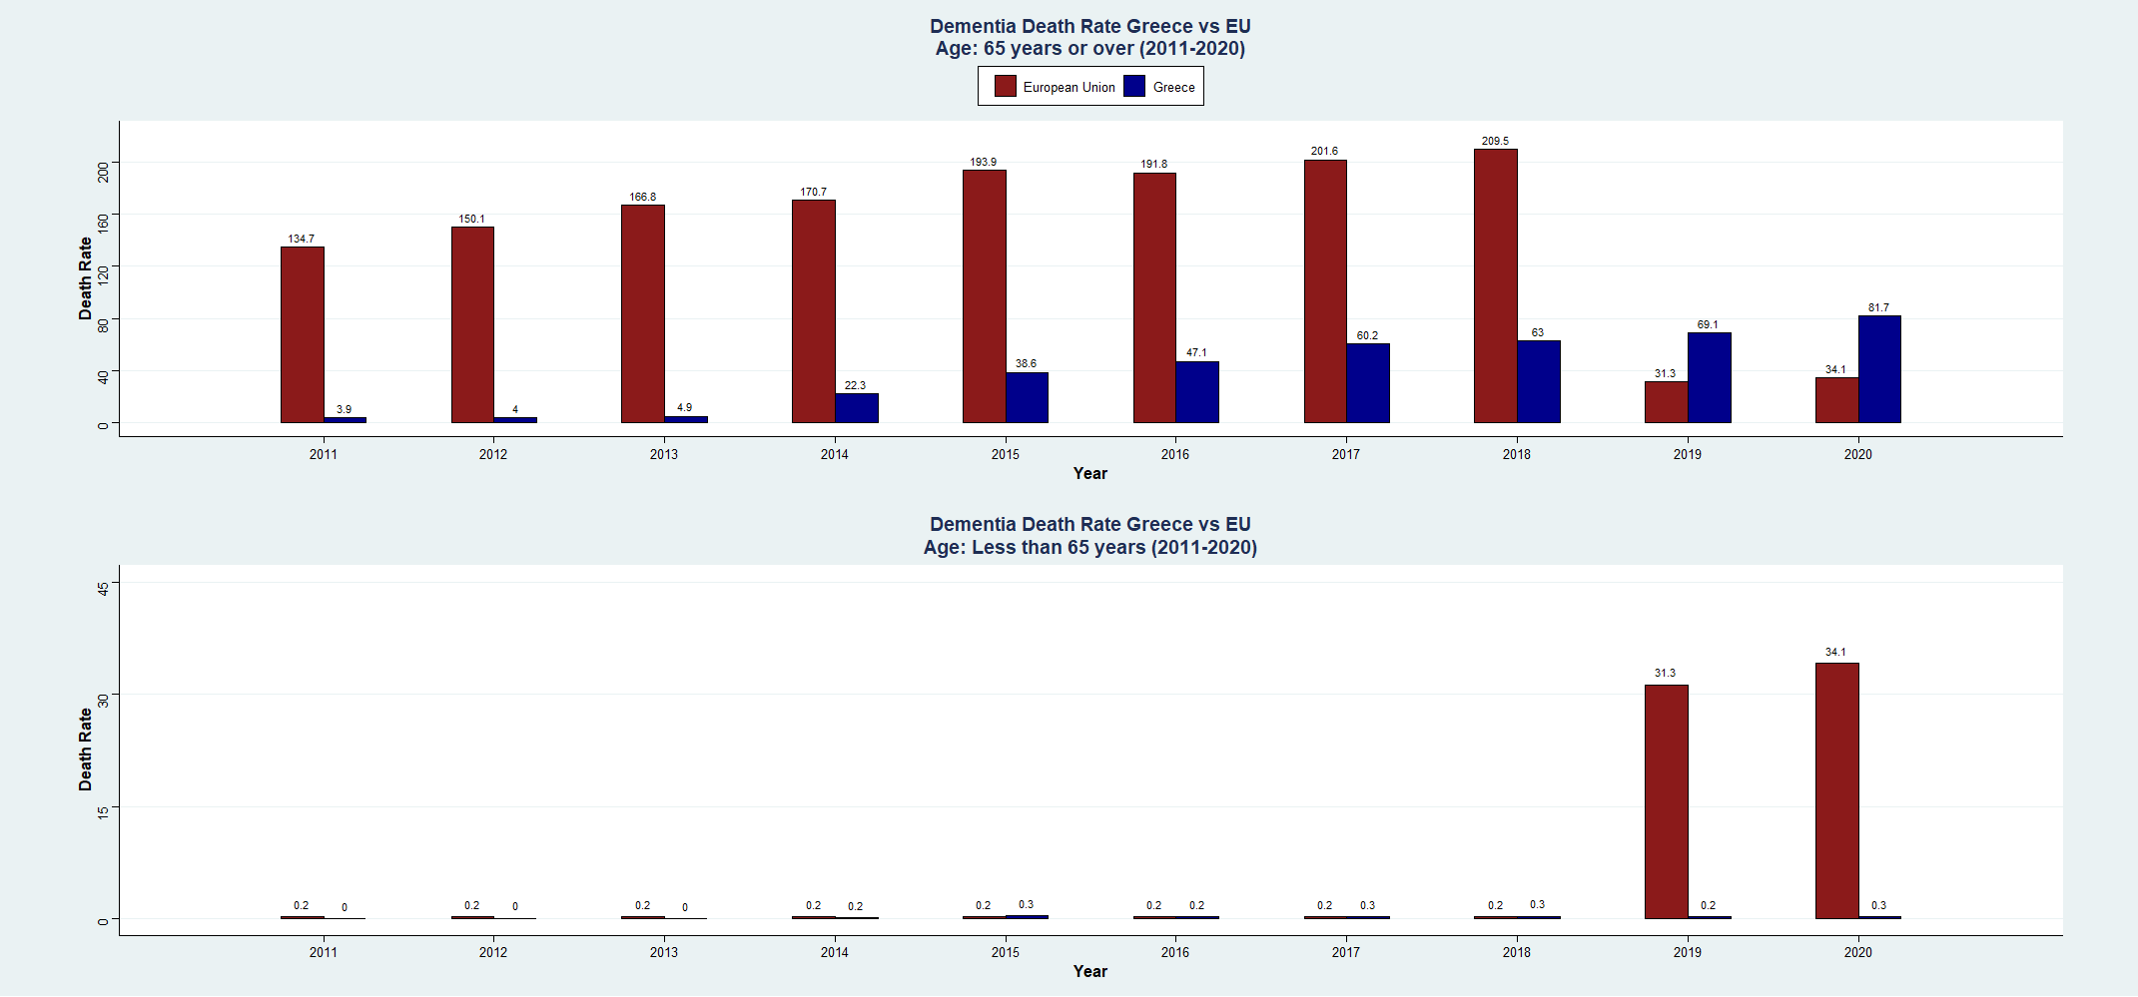
Project analysis slide 10
Dementia Death Rate Greece vs EU by Age (2011-2020)
This graph shows a comparison of the dementia death rates between Greece and the European Union (EU) for two different age categories: "65 years or over" and "Less than 65 years.“
The EU values for the years 2019 and 2020 are suspicious since the provided data from Eurostat are the same for all categories (31.3 & 34.1 - gender, ages, totals) and will not taken into consideration.
Regarding the other years it is obvious that the over 65 years category have way higher rates than the under 65 one, which both in Greece and EU can be considered 0.
For the “65 years or over" category a rising trend can be noticed for both Greece and EU.
Dimitrios Matsanganis, f2822212
Analytics Practicum II - Project I

Slide 15
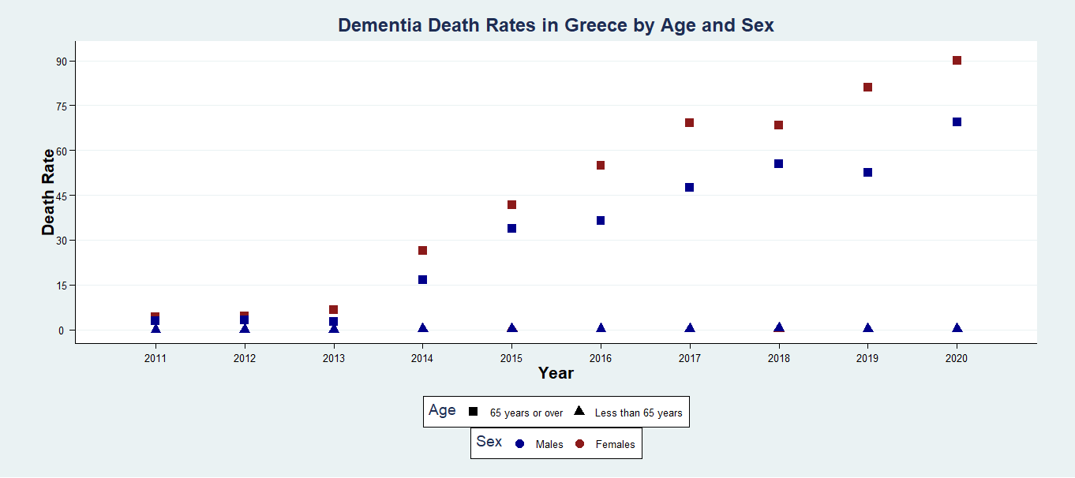
Project analysis slide 10
Dementia Death Rates in Greece by Age and Sex (2011-2020)
This scatterplot represents with squares the over 65 age category and with triangles the under 65 years one. Regarding the gender the males are representing with blue and the females with red.
As it noticed earlier as well, this graph verifies that there is a rising trend in Greece’s dementia death rates regardless the gender for the elder people (over 65). Furthermore, the females are appeared to having the higher vales in this age category in all years.
It is needed to be pointed out an abnormal decrease for males in 2019 and for females in 2018 (both referring to the over 65 category).
The under 65 years category presents very low values about 0.5 for all years, regardless the gender.
Dimitrios Matsanganis, f2822212
Analytics Practicum II - Project I

Slide 16
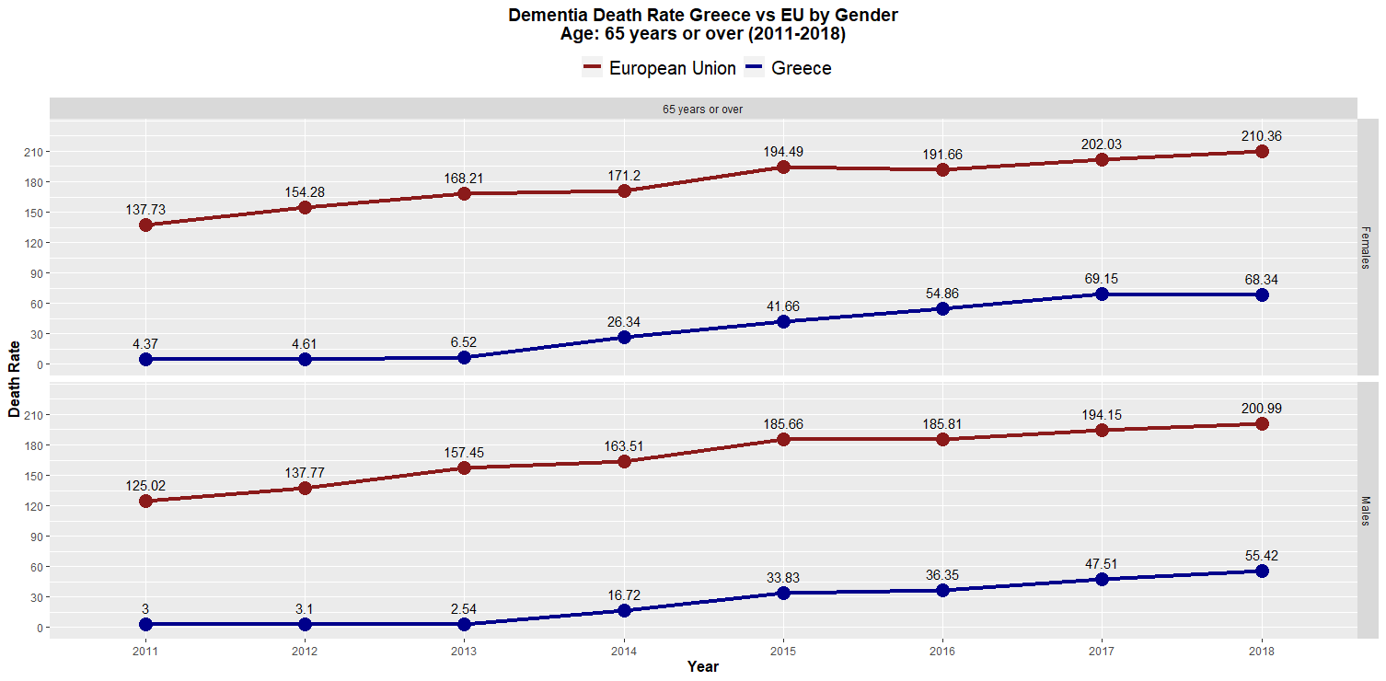
Project analysis slide 10
Dementia Death Rate Greece vs EU by Gender aged 65 or over (2011-2020)
This graph is a line chart comparing the Greece and European Union based on the age category over 65 years old and gender wise. The years 2019 and 2020 were excluded since the EU values seems to be invalid.
Based on the graph, the Females achieve higher death rates than Males in all years and in both Greece and EU.
The observed trend exhibits a general inclination towards growth, punctuated by intermittent minor decreases occurring periodically, as exemplified by the 2016 average of the European Union for both genders.
The higher value in EU is 210.36 by Females in 2018, while in Greece the bigger one is again from Females in the prior year 69.15. Finally, EU has significantly higher death rate from Greece in both genders.
Dimitrios Matsanganis, f2822212
Analytics Practicum II - Project I

Slide 17
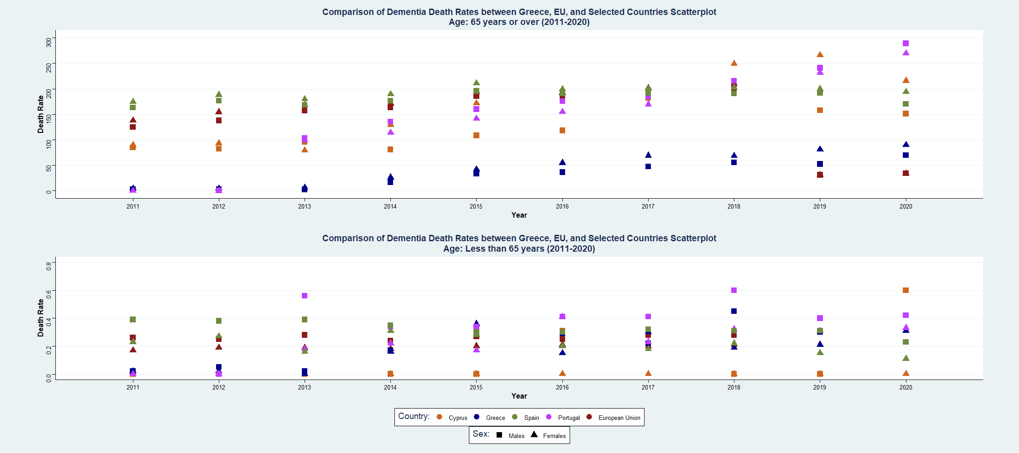
Project analysis slide 10
Comparison of Dementia Death Rates between Greece, EU, and Selected Countries Scatterplot (2011-2020)
This scatterplot compares dementia death rates between Greece, the EU, Cyprus, Spain, and Portugal for different age groups and genders from 2011 to 2020. The above subgraph is referring to ages over 65 and the range of the values is 0 to 289, while the second one is referring to the under 65 category and the range is 0 to 0.8.
As it can be noticed, persons under 65 years old are way less probably to die from dementia (0.8 to 290). The higher rate belongs to Portuguese Males over 65 in the 2020 followed by the Females of the above category and country.
Greece no matter the rising trend on over 65 aged people, is significant below the other - similar - countries values (we exclude the EU’s average as mentioned earlier).
Dimitrios Matsanganis, f2822212
Analytics Practicum II - Project I

Slide 18
Project analysis slide 10
Comparison of Dementia Death Rates Scatterplot GIF (2011-2020)
This scatterplot GIF finalizes our analysis that Greece has an rising trend regarding the dementia death rates, as most of EU countries, but is relatively lower than the most of them and the EU’s average (reliable data up to 2018).
Greece is notated by its initials “GR” to be targeted easier and all the other countries are notated by a color representing their flag and a two-letters abbreviation (e.g. Denmark = DK).
Higher values of dementia death rates can be found to the UK (data up to 2018), the Netherlands, and surprisingly Malta.
Dimitrios Matsanganis, f2822212
Analytics Practicum II - Project I

Slide 19
Thank you

